Slide 1
Icon Bank
User Persona and Places

Slide 2
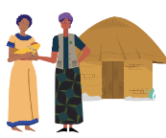
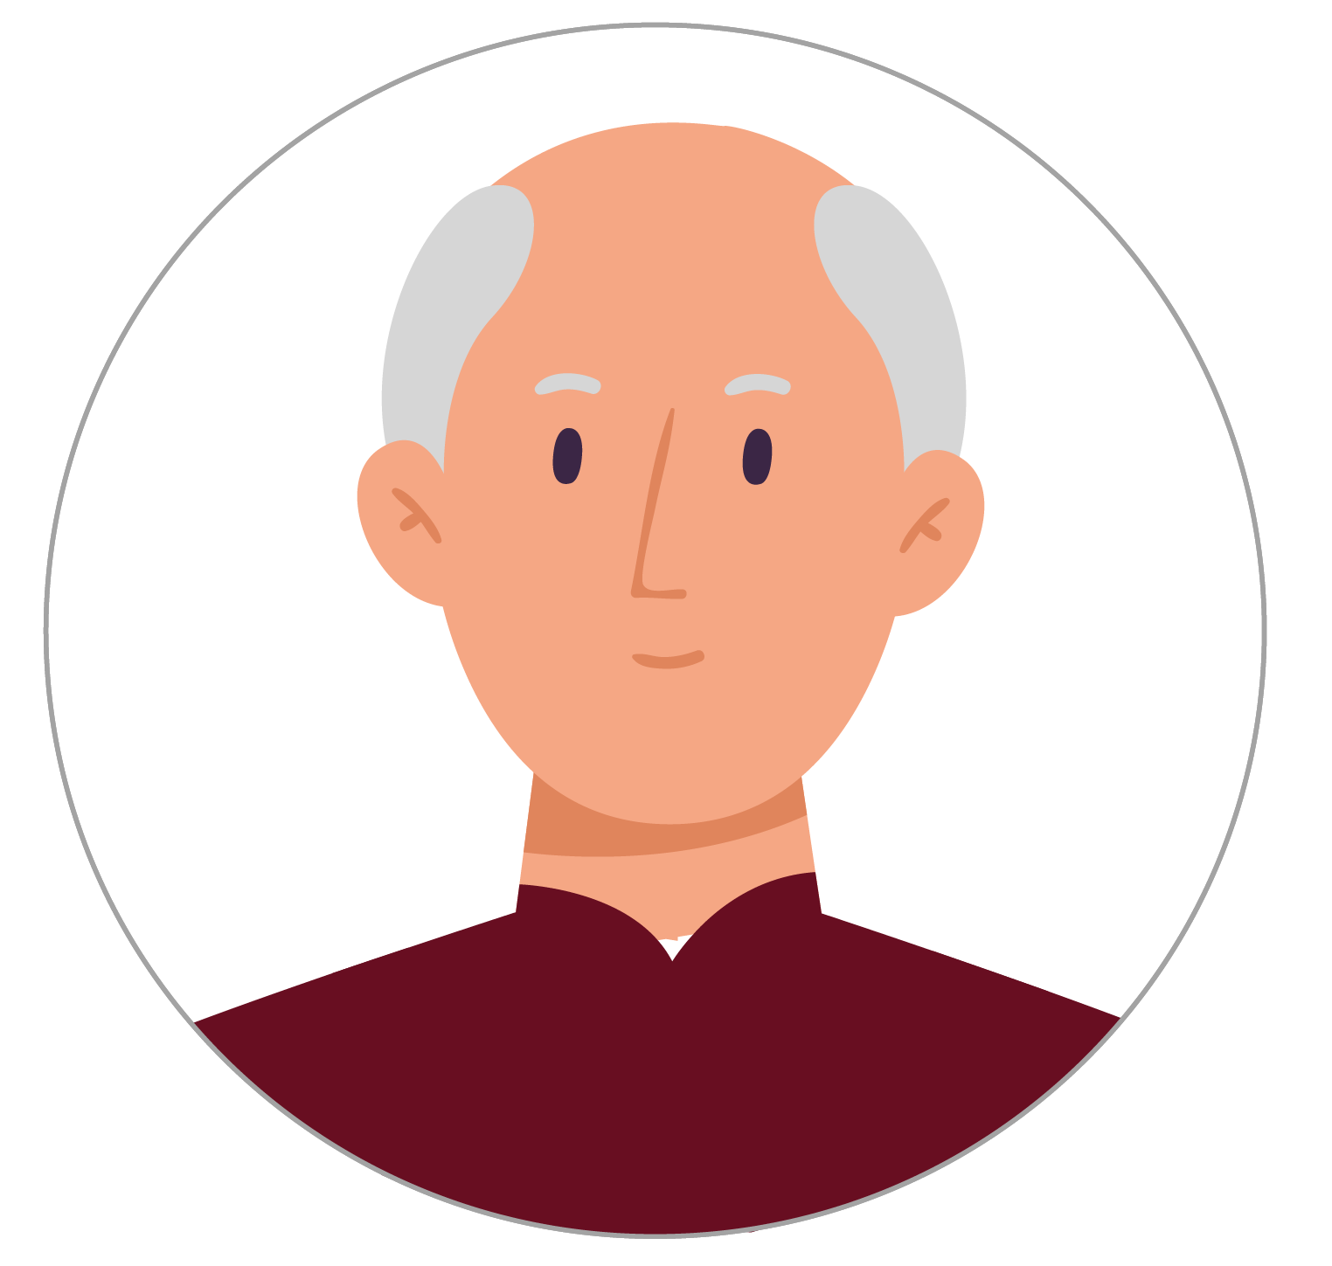
Personas
CHW
Facility Nurse
Social Worker
Clients
Village Leader

Slide 3
Places
Homes
Health Facility
School
Civil Registry Office
Transportation
Items/Other

