Slide 1
DCS Workshop
User Person Templates

Slide 2
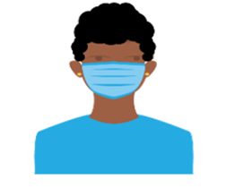
User persona template
 | Name: Job Title
 | Demographics | Age: Experience: Context:
Responsibilities
Primary Narrative Workflows/Stories
Challenges, pain points and bottlenecks

Slide 3
User persona template
 | Name: Zuri Job Title/Role: Community Health Worker (CHW)
 | Demographics | Age: 27 Experience: Zuri has been a CHW for two years. Context: Zuri lives in Mwanza Rural District. She visits 15-20 homes daily. The majority of families she visits live in homes without electricity, running water, or internet connection.
Responsibilities | Zuri works with clients to bridge the gap between healthcare providers and underserved communities. She provides support, advocacy, outreach, and assistance in accessing healthcare services and other resources.
Primary Narrative Workflows/Stories | Zuri conducts home visits to check on clients, provide health education, and assists with adherence to medical treatments. She advocates for preventive care and collaborates with local facilities for service provision. Zuri conducts health screenings and assessments, provides basic medicines and health supplies, and updates the clients’ records. When the clients require additional care, she reports danger signs and refers them for social services or to the nearest health clinic.
Challenges, Pain Points, and Bottlenecks | Travel distance between homes in her village (Zuri uses a bicycle for her household visits; however, travel can be difficult during the rainy season). It is difficult to manage and update records based on her register and notes. Zuri carries her register book, education materials, and drugs and commodities in her backpack, which is very heavy. Zuri has a basic mobile phone which can send and receive SMS messages. There is limited internet connectivity in her village, and she cannot charge her device in her household.

Slide 4
User persona template
 | Name: Nandi Job Title/Role: Nurse
 | Demographics | Age: 45 Experience: Nandi has 15 years of experience and a formal diploma in nursing. Context: Nandi is a nurse at Mbane Rural Clinic. She sees around 40-60 client a day, covering multiple program areas such as ante- and pre-natal care (ANC/PNC), family planning, immunizations, HIV/AIDS, TB and malaria. She is literate in English, as well as several local dialects. She works 12-hour days and wishes she could spend more time with her husband and three children.
Responsibilities | Nandi is a dedicated nurse committed to delivering medical services and patient education. She works to enhance patients' well-being by assessing patients and providing primary care services (such as delivering vaccines and diagnosing and managing treatment of HIV-positive clients). She also oversees CHWs like Zuri.
Primary Narrative Workflows/Stories | Nandi conducts medical evaluations, routine check-ups, treatment, and counseling for patients. She reviews patient records and prepares for the upcoming day's appointments. Collaborating closely with Zuri and Tendayi, Nandi ensures the seamless and continuous provision of care to the community.
Challenges, Pain Points, and Bottlenecks | Heavy workload, with high patient volume. On top of seeing clients, she is responsible for coordinating and conducting health education sessions, managing CHWs, and reporting service delivery statistics. It is complicated and difficult to coordinate with CHWs to trace clients in the community who need follow-up and to ensure ongoing care and monitoring in the community. Facility-based registers, tally sheets, and reports are time-intensive, and it is difficult to manage the requirements across different health programs. Nandi has a smartphone with limited connection to the internet. She often uses her own airtime for work-related issues. The facility has one working computer, limited internet connection, and relies on solar power as the main source of electricity.

Slide 5
User persona template
 | Name: Tendayi Job Title/Role: Social Worker
 | Demographics | Age: 35 Experience: Tendayi has been working as a Social Worker for eight years. Context: Operating within the Mwanza Rural District, Tendayi provides services for assessing, supporting, and advocating for individuals and communities facing social and emotional challenges. She excels in connecting them to essential resources and services, contributing to their overall well-being.
Responsibilities | Tendayi collaborates closely with clients to enhance empowerment, resilience, and social and economic stability in vulnerable individuals, families, and communities. Her role involves linking clients to social services and promoting their overall well-being in the face of adversity.
Primary Narrative Workflows/Stories | Tendayi actively engages with families, conducts thorough assessments, and develops comprehensive care plans. These plans often include facilitating access to healthcare and various support services. She coordinates seamlessly with key stakeholders such as the CHW, Zuri, the nurse, Nandi, and community organizations. Tendayi reviews case notes, maintains open communication with colleagues, and plans follow-up visits, ensuring that clients receive the necessary support based on their needs.
Challenges, Pain Points, and Bottlenecks | Tendayi faces hurdles in ensuring effective communication with colleagues, community organizations, and healthcare providers. Coordination difficulties arise in managing efforts among diverse stakeholders. Tendayi encounters challenges in reaching and engaging with vulnerable individuals and communities due to low awareness about available services. Limitations arise when trying to integrate client information across different platforms or systems used by various stakeholders. Maintaining accurate and up-to-date client records is crucial for Tendayi; she needs to ensure that all relevant information is documented correctly to provide comprehensive and effective support.

Slide 6
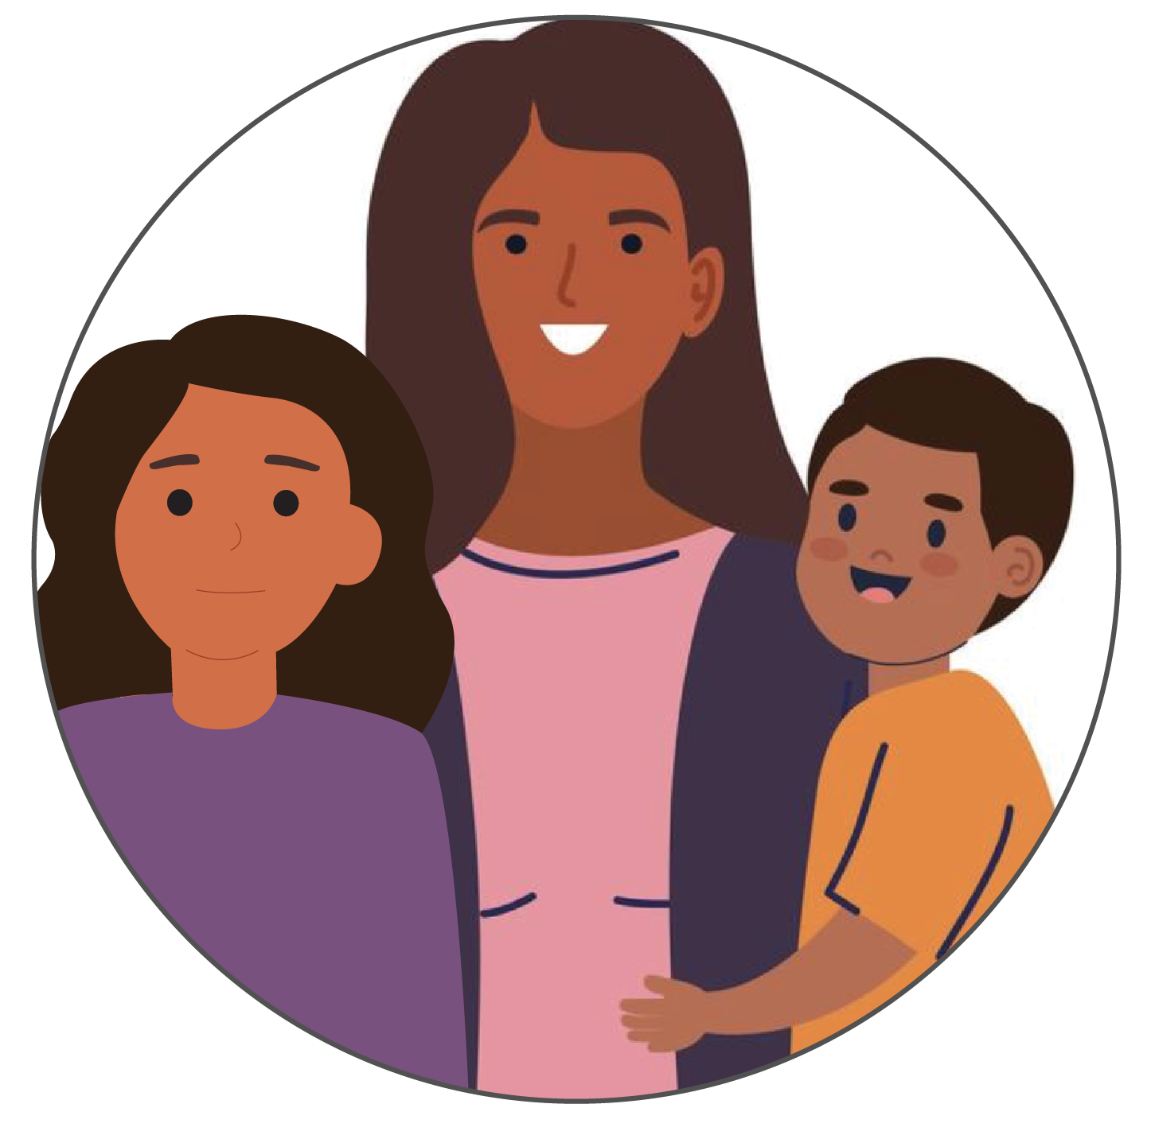
User persona template
 | Name: Lerato Job Title/Role: Client
 | Demographics | Age: 32 Experience: Lerato is a single mother with a five-year-old son, Robert, and a thirteen-year-old daughter, Stella. Context: Lerato engages in informal work to support her family financially and lives in Mwanza Rural District, where access to healthcare and other social services is limited. She was enrolled in the community health program one year ago.
Responsibilities | Participating in health screenings for herself and her children. Overseeing the health and education goals for her children. Attending educational sessions provided by the CHW. Engaging with various healthcare and social services as recommended by the CHW.
Primary Narrative Workflows/Stories | Lerato receives frequent visits from the CHW, Zuri, who conducts screenings, provides education on health-related topics, and connects her with different services as needed. Lerato tried to attend follow-up appointments and meetings with her CHW and providers as scheduled, but sometimes loses her referral slips or forgets appointments.
Challenges, Pain Points, and Bottlenecks | Long distances and transportation issues make it difficult for Lerato to access healthcare and social services promptly. Lerato's irregular work hours often conflict with scheduled appointments, making it challenging for her to attend all necessary meetings. Juggling informal work and childcare responsibilities makes it difficult for Lerato to consistently prioritize her and her children's health needs. Limited connectivity in the rural area hinders effective communication between Lerato and healthcare providers.

Slide 7
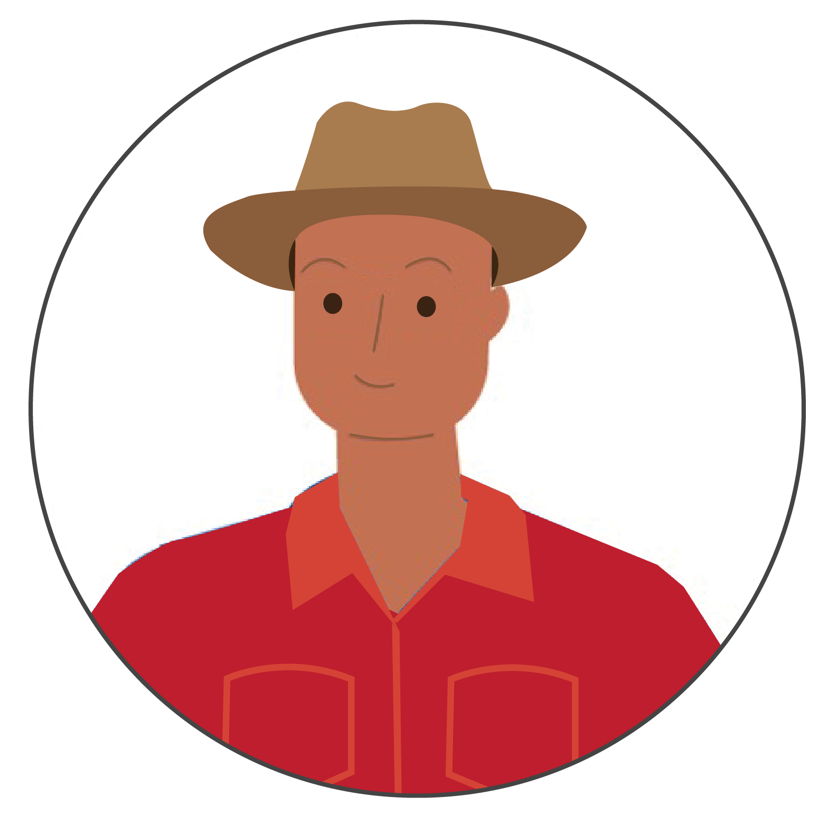
User persona template
 | Name: Ndlovu Job Title/Role: Client
 | Demographics | Age: 38 Experience: Ndlovu is a livestock sales worker who engages in multiple and concurrent sexual partnerships (MCP) with men. Context: Ndlovu's job involves frequent travel to transport animals to different farmers, ranchers, and agricultural businesses. This often results in long hours and irregular schedules, leaving him with some limitations accessing health services. He is enrolled in a health program at the Umoja facility, driven by the desire to maintain his well-being.
Responsibilities | Ndlovu attends scheduled health check-ups, follows the prescribed guidelines provided, and participates, when possible, in educational sessions aimed at promoting a healthy lifestyle.
Primary Narrative Workflows/Stories | Ndlovu visits the Umoja facility for health check-ups, attends scheduled checkpoints or referrals for specialized services, and undergoes thorough medical examinations. He coordinates with the CHW, Zuri, and the nurse, Nandi, to discuss specific health concerns and receive personalized advice.
Challenges, Pain Points, and Bottlenecks | Aligning health program appointments with his travel schedule can be challenging. This often requires careful planning and coordination to ensure he doesn't miss crucial check-ups or educational sessions. Limited access to the Umoja facility during work-related travels. This constraint could potentially lead to delays in receiving necessary health services, affecting the overall effectiveness of the program for Ndlovu. There is a need to search for more personalized and tailored scheduling support within the existing health program to accommodate his work. Ndlovu faces stigma and discrimination due to his MCP with men. This deters him from seeking health services or sharing his concerns openly, impacting the quality of care he receives.

Slide 8
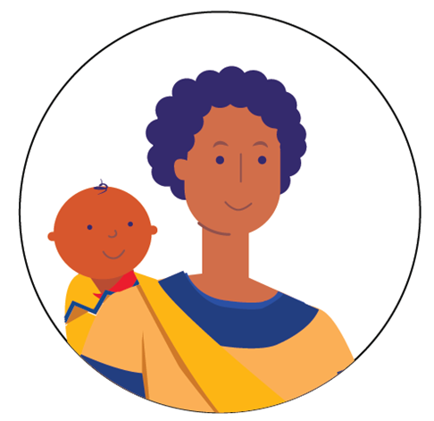
User persona template
 | Name: Thandiwe Job Title/Role: Client
 | Demographics | Age: 32 Experience: Thandiwe is married and has a newborn son, Joseph. Context: Thandiwe lives in Mwanza Rural District. She works as a crafts vendor in the local market and resides in a single-room house without electricity in a small village with her husband. Recently, she gave birth to Joseph at home, as she could not afford transport to the health facility for delivery.
Responsibilities | Thandiwe 's primary responsibility is to safeguard her newborn, Joseph, from preventable infectious diseases during this vulnerable post-natal period. This includes maintaining a hygienic home environment, practicing exclusive breastfeeding, monitoring Joseph's health, and actively engaging with healthcare providers for regular check-ups.
Primary Narrative Workflows/Stories | Thandiwe and Joseph embark on a journey to the local health facility for Joseph's crucial birth dose immunizations. Navigating the challenges of transportation in their rural setting, they reach the health facility, emphasizing Thandiwe 's determination to prioritize Joseph's health. Upon arrival, Thandiwe and Joseph are welcomed by healthcare professionals who administer the necessary immunizations. The healthcare team takes the opportunity to provide Thandiwe with information about PNC, reinforcing the importance of follow-up appointments and ongoing health monitoring for Joseph.
Challenges, Pain Points, and Bottlenecks | Challenges in regularly accessing the health facility due to lack of resources for reliable transportation Lack of information or understanding about the necessity of follow-up visits for both the mother and the newborn could result in missed opportunities for essential healthcare. Scheduling and attending PNC appointments may be challenging due to Thandiwe 's responsibilities as a craft vendor and the demands of caring for a newborn. This can result in missed appointments, leading to gaps in Joseph's healthcare and developmental assessments.

