Slide 1

[Country Name]
[Country logo]
Digital Community System Presentation

Slide 2
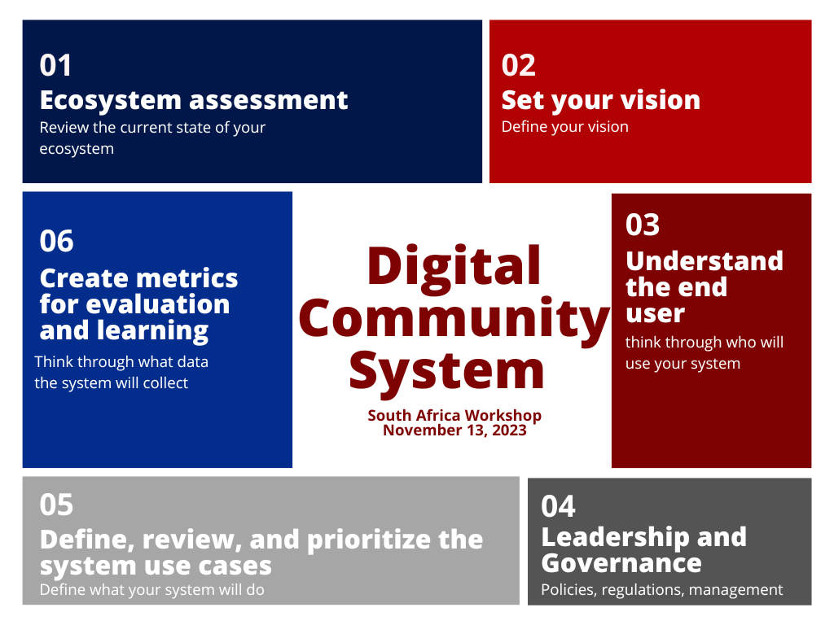
Digital Community System Presentation - our work so far

Slide 3
Vision

Slide 4
Digital Community Systems Vision Statement

Slide 5
Relevant Baseline Information

Slide 6
Baseline and stocktaking framework
Areas | Strengths | Major gaps
Leadership and Governance
Data Governance, Legislation and Policy
Funding for CHW Digital Health
Digital Health Capacity, Implementations and Standards
Technical Capacity and Infrastructure

Slide 7
Baseline and stocktaking framework
Areas | Strengths | Major gaps
Scale and Scope of digital community health systems
Interoperability with Other Health Information Systems
Appropriate Digital Health for Management and Quality of CH Programs
Operational logistics
CHW digital literacy
Program Data Use

Slide 8
User Personas

Slide 9

User persona template (update and duplicate as needed)
 | Persona​ | Name, Job Title (eg: Joseph Dube, District Health Information Manager)
 | Demographics | Age: Experience: Context description:
Responsibilities​
Primary narrative workflows / journey
Challenges, pain points, and bottlenecks

Slide 10
Journeys

Slide 11











Journey 1: [PERSONA] + [Journey]
Current State
Step 1
[ENTER TEXT HERE]
Step 2
Step 3
Step 4
Step 5
ENTER TEXT HERE: CHALLENGE IN CURRENT STATE
ENTER TEXT HERE: CHALLENGE IN CURRENT STATE
ENTER TEXT HERE: CHALLENGE IN CURRENT STATE
ENTER TEXT HERE: CHALLENGE IN CURRENT STATE
ENTER TEXT HERE: CHALLENGE IN CURRENT STATE

Slide 12
Prioritized Use Cases

Slide 13
[DELETE SLIDE]
Consider how your prioritized use cases will address challenges from current state

Slide 14
Prioritized Use Cases
Future State: [persona]
Use case 9
Use case 1
Use case 8
Persona image here
Use case 2
Use case 7
Use case 3
Use case 6
PERSONA NAME & ROLE
Use case 5
Use case 4

Slide 15
Prioritized Use Cases
Future State: [persona]
Use case 9
Use case 1
Use case 8
Persona image here
Use case 2
Use case 7
Use case 3
Use case 6
PERSONA NAME & ROLE
Use case 5
Use case 4

Slide 16
Prioritized Use Cases
Future State: [persona]
Use case 9
Use case 1
Use case 8
Persona image here
Use case 2
Use case 7
Use case 3
Use case 6
PERSONA NAME & ROLE
Use case 5
Use case 4

Slide 17
Leadership, Governance and Coordination

Slide 18
Governance, Leadership and Coordination - Structures
Current
Proposed
??? Steering Committee
___ TWG
____ TWG
____ Task Team
__________
___________
__________

Slide 19
Governance, Leadership and Coordination - Structure
Areas | Membership | Roles and Responsibilities
Steering Committee. | ex: Key Ministries, Departments and Agencies Senior Mgmt Decision Makers Development or Funding Partners | Meet annually to review progress on key results indicators, annual work plan and budget.
_____ TWG | ex: Department Heads, Technical Representatives from MDA Implementing Partner Leadership
_______ Task Team
_____ TWG
New Proposed TWG
__New Proposed_______ Task Team 3

Slide 20
Enabling Environment

Slide 21
Enabling Environment: Current and Future State
Enabling Environment | Challenges and gaps | Action steps
Strategy and investments
Services and applications
Standards and interoperability
Infrastructure
Legislation,policy and compliance
Workforce

Slide 22
Monitoring progress and continuous learning

Slide 23
Monitoring Progress and Continuous Learning
Indicators | Baseline Status | Future Targets
ex: Client Level Identified Data Coverage For Service Provision

Slide 24
Other Important Areas

Slide 25
Next Steps

Slide 27
Icon Bank

Slide 28









Personas
CHW
Facility Nurse
Social Worker
Clients
Village Leader

Slide 29

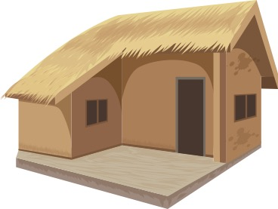













Places
Homes
Health Facility
School
Civil Registry Office
Transportation
Items/Other

Slide 30
































Use Cases

Slide 31
ARCHIVE

Slide 32


Existing and planned digital community systems by core functionality
Core function | DHI classification | Operational | Planned | Priority
EXAMPLE: Manage inventory and distribution of commodities. | 3.2.1 | No | Yes | High
Key
2.0 Healthcare providers
3.0 Health systems or resource managers
4.0 Data services
Priority: High: within 1 year; Medium: within 1-3 years; Low: 3 or more years out

Slide 33
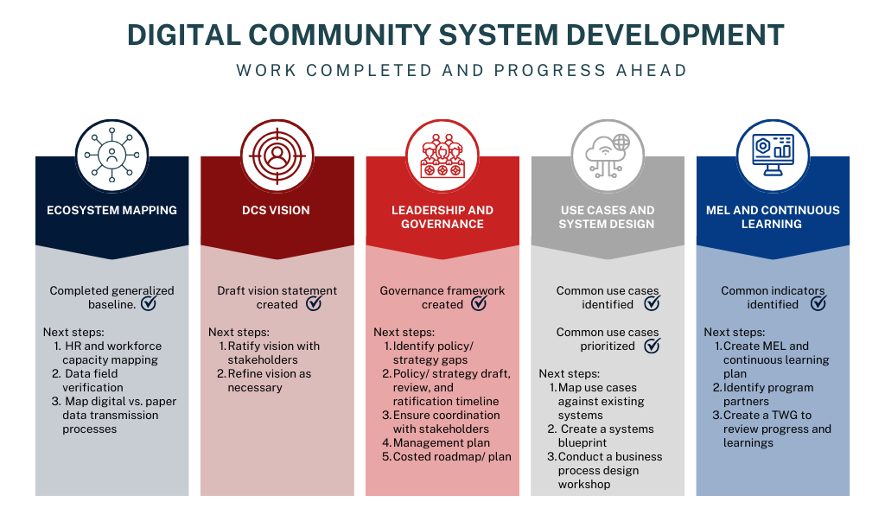

Slide 34
Use cases and system functionalities
Use case | System link | Existing / Planned | Priority (1-5)
Example: Community follow up for missed appointments or services. | Example: RapidPro in use by facilities and with CHWs | Example: existing in 25% of communities | 1
Priority: High: within 1 year; Medium: within 1-3 years; Low: 3 or more years out

